Slide 1
Polymorphism in C#
Greek word, meaning "one name many forms".

Slide 2
one object has many forms or has one name with multiple functionalities. "Poly" means many and "morph" means forms. Polymorphism provides the ability to a class to have multiple implementations with the same name. It is one of the core principles of Object Oriented Programming after encapsulation and inheritance

Slide 3
Types of Polymorphism
There are two types of polymorphism in C#:
1. Static / Compile Time Polymorphism.
2. Dynamic / Runtime Polymorphism.

Slide 4
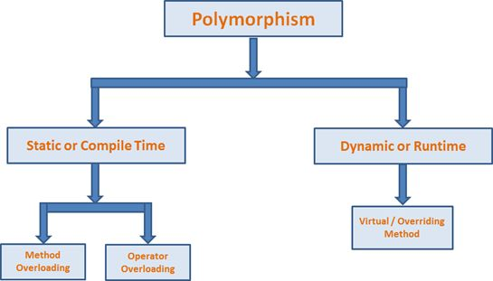

Slide 5
Static or Compile Time Polymorphism
It is also known as Early Binding. Method overloading is an example of Static Polymorphism. In overloading,
the method / function has a same name but different signatures. It is also known as Compile Time Polymorphism because the decision of which method is to be called is made at compile time. Overloading is the concept in which method names are the same with a different set of parameters.
Here C# compiler checks the number of parameters passed and the type of parameter and make the decision of which method to call and it throw an error if no matching method is found.

Slide 6
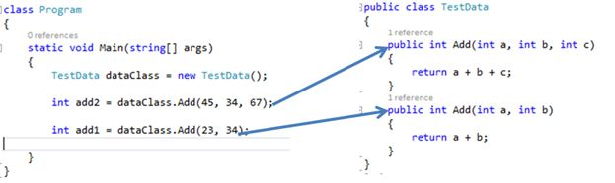
Understanding ..

Slide 7
Dynamic / Runtime Polymorphism
Dynamic / runtime polymorphism is also known as late binding. Here, the method name and the method signature (number of parameters and parameter type must be the same and may have a different implementation). Method overriding is an example of dynamic polymorphism.
Method overriding can be done using inheritance. With method overriding it is possible for the base class and derived class to have the same method name and same something. The compiler would not be aware of the method available for overriding the functionality, so the compiler does not throw an error at compile time. The compiler will decide which method to call at runtime and if no method is found then it throws an error.

Slide 8
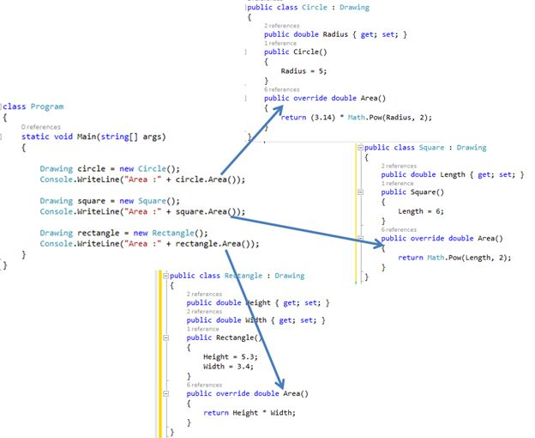

Slide 9
C# provides an option to override the base class method, by adding the by adding the keyword to the method inside the base class, and by using the override keyword for each derived class methods:

Slide 10
Key points of Method overloading
Method overloading is also called early binding or compile time polymorphism or static binding.
The compiler automatically calls the required method or the function by checking number of parameters and their type, which are passed into that method.
If the number of parameters and type doesn't match by any method signatures, then it will give the compile time error.
We can achive method overloading by changing the number of parameters used or by using different types of parameters or by changing the order of parameters

Slide 11
Key points of Method overriding
Method overriding is also called run time polymorphism or dynamic polymorphism or late binding.
We can override a method in the base class by creating similar function in the derived class. This can be achieved by using inheritance and using virtual & override.
Same signature means the methods must have the same name, same number of arguments and same type of arguments.
Method overriding is possible only in the derived classes, but not within the same class.
When the derived class needs a method with the same signature as in the base class, but wants to execute different code than the one provided by the base class then method overriding will be used.
Method overriding in C# is a feature like the virtual function in C++

Slide 12
Important key words
Virtual keyword If we use Virtual keyword, then we tell to compiler that this method can be overridden by the derived classes
Override keyword If we use Overrride keyword, then we tell to the compiler that this method is overriding the same named method in the base class.
Base keyword If we use base keyword, then we tell to the compiler that this method calls the base class method for overriding functionality.

